Slide 1


Predicting Home Loan Eligibility Using Machine Learning
Group 11 Project
Sakshi Agarwal • Haley Hoang • Mayar Abdelhade • Emelia Appiah • Divya Katamneni
Notes:
1

Slide 2




Business Context & Objective
Strengthen Revenue with Smarter Lending
Manual Reviews Limit Efficiency
Home loans are a critical revenue stream, but poor approval decisions increase exposure to credit risk.
Current loan assessments are slow, inconsistent, and difficult to scale as application volumes grow.
Leverage Data to Predict Approvals
Reduce Risk with Data-Driven Decisions
Machine-learning models can analyze historical applications to reliably estimate approval likelihood
Accurate predictions help Easy House focus on strong applicants, lower default rates, and optimize portfolio quality.
Notes:
2

Slide 3

Data Overview: Dataset & Key Variables
~600 historical loan applications
Target: Loan_Status (1 = Approved, 0 = Not Approved)
Predictors include:
Demographics: Gender, Married, Education, Dependents, Self-Employed
Financials: ApplicantIncome, CoapplicantIncome, LoanAmount, Loan_Amount_Term
Risk indicators: Credit_History
Property_Area: Urban / Semiurban / Rural
Notes:
3

Slide 4
Data Preprocessing: Cleaning and Transformation
01
02
03
Impute Missing Values
Remove Loan_ID
One-Hot Encode
Around 20% of values were missing.
Categorical filled using mode, numerical using median.
Result: Missing values reduced to 0% with no loss of rows.
No predictive value, removed for cleaner data.
Result: Reduced noise and improved model interpretability.
Applied to Gender, Education, Property_Area.
Result: Expanded feature space with 6 additional encoded variables.
04
05
Binary Map
Scale Numerical Features
Married and Self-Employed mapped to 0/1.
Result: Simplified categorical interpretation for linear models.
StandardScaler is used for consistent numerical ranges.
Result: Prevented high-magnitude features from dominating Logistic Regression.
Notes:
4

Slide 5
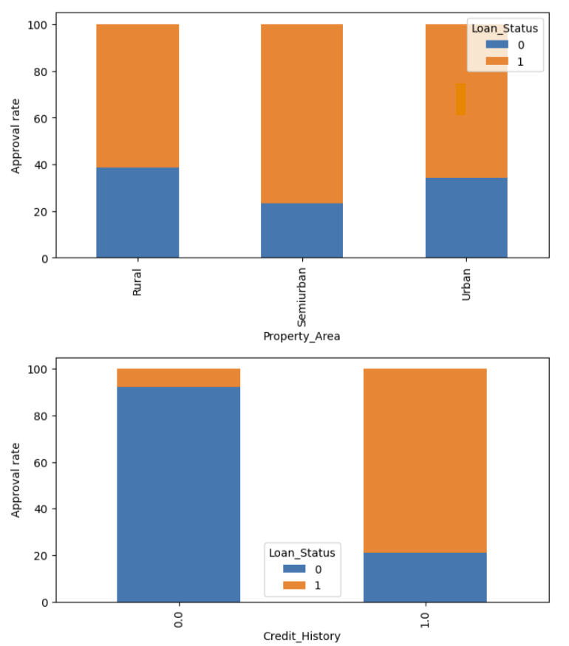
Exploratory Analysis – Who Gets Approved?
Key EDA Insights:
Approval Distribution: ~68% approved, ~32% not approved → moderate imbalance.
Credit History: Applicants with positive credit history show the highest approval rates.
Property Area: Semiurban applicants have the highest approval rate, followed by Urban.
Demographics: Married and graduate applicants show slightly higher approval likelihood.
Income & Loan Patterns: No strong linear relationship, but income is right-skewed with some outliers
Overall Takeaway:
Approval is strongly driven by credit history and property area, with smaller effects from demographics.
Notes:
6

Slide 6
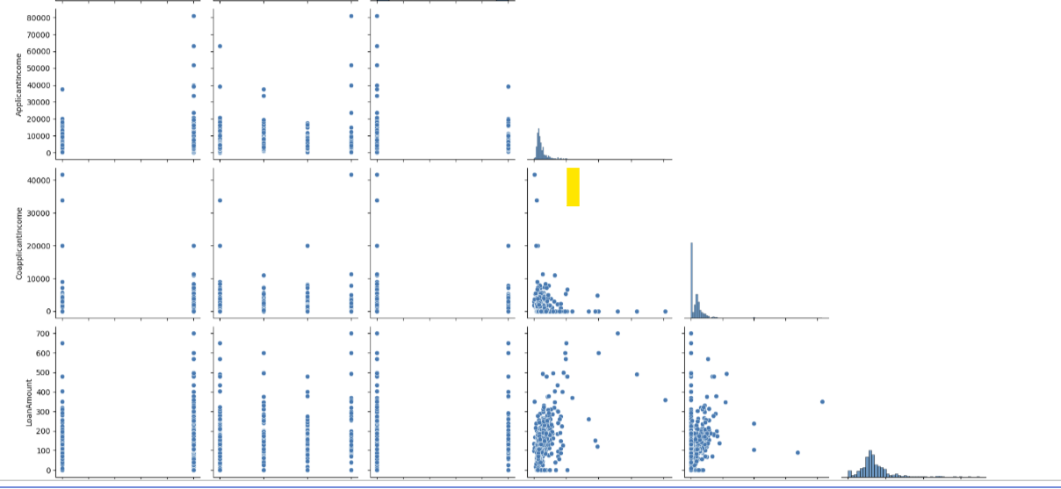
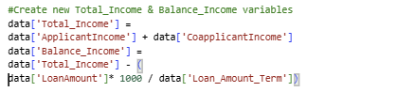
Feature Engineering & Outlier Handling
01
New Features:
02
Outlier Removal
03
Noise Reduction
Engineered financial stability indicators:
Total_Income (overall earning capacity)
Balance_Income (disposable income after EMI)
These features better represent the true repayment ability of applicants.
Applied Z-score > 3 to detect and remove extreme values in income and loan amounts.
Removed ~3.75% extreme records
Increased model smoothness and reduced variance during training.
Notes:
5

Slide 7
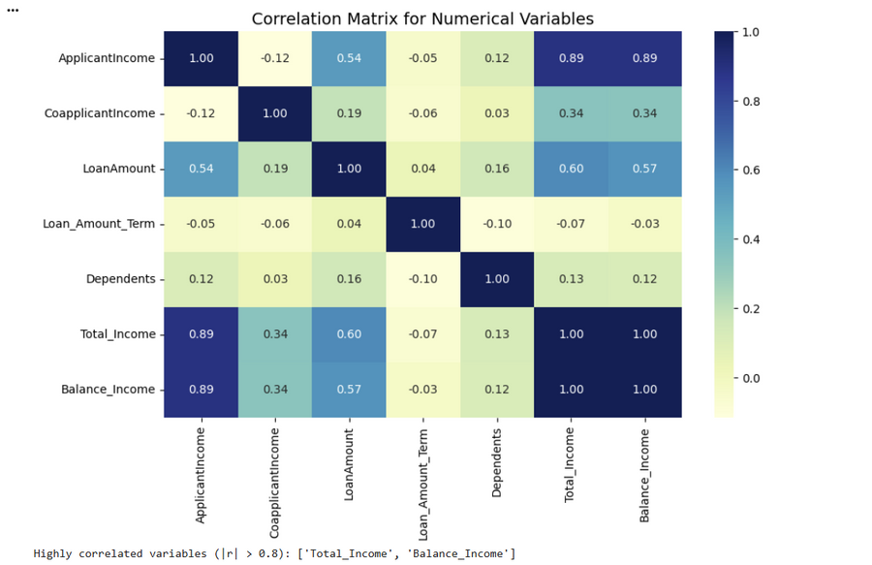
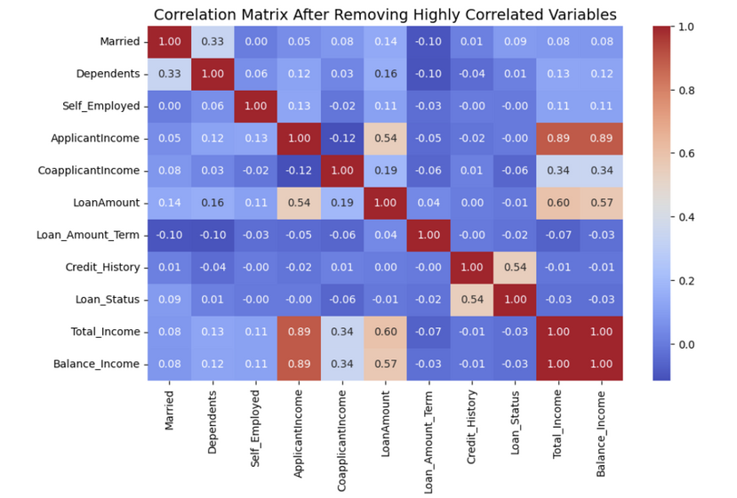
Correlation Matrix Analysis:
Correlation Findings
High correlation (r > 0.85) between:
ApplicantIncome ↔ Total_Income
Total_Income ↔ Balance_Income
Decision:
We kept all three income features because:
They represent distinct financial meanings
Tree-based models are robust to multicollinearity
Removing them would reduce the financial signal
Notes:
7

Slide 8
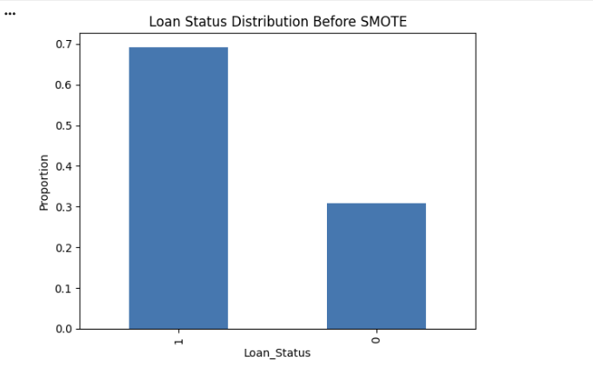
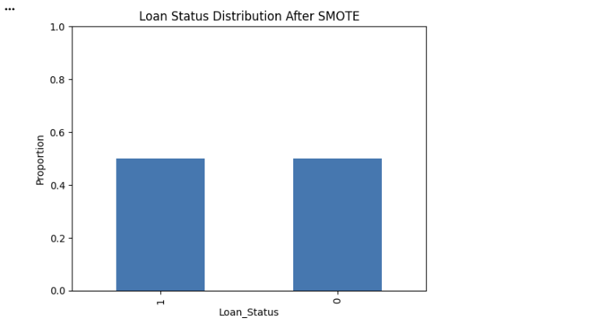
Addressing Class Imbalance with SMOTE
Original Target Imbalance
Approach
Balanced Training Set
1
2
3
68% approved, 32% not approved. Risk of models over-predicting "Approve."
Train–test split (70:30)
Applied SMOTE on training data only.
Training set balanced to 50% approved / 50% not approved for fair model learning.
Notes:
8

Slide 9





Model Selection & Evaluation Metrics
Models Evaluated
Logistic Regression, Decision Tree, Random Forest.
Evaluation Metrics
Accuracy, Precision, Recall, F1, ROC–AUC, 5 fold Cross-Validation.
Business Goal: Avoid Risky Approvals
Crucial to prevent approving borrowers with high default risk.
Business Goal: Qualify Applicants
Equally important to avoid rejecting qualified applicants.
Notes:
9

Slide 10


Predictive Modeling: Logistic Regression Baseline
Starting with Logistic Regression offers a transparent, interpretable baseline for binary outcomes like loan approvals.
Notes:
1

Slide 11
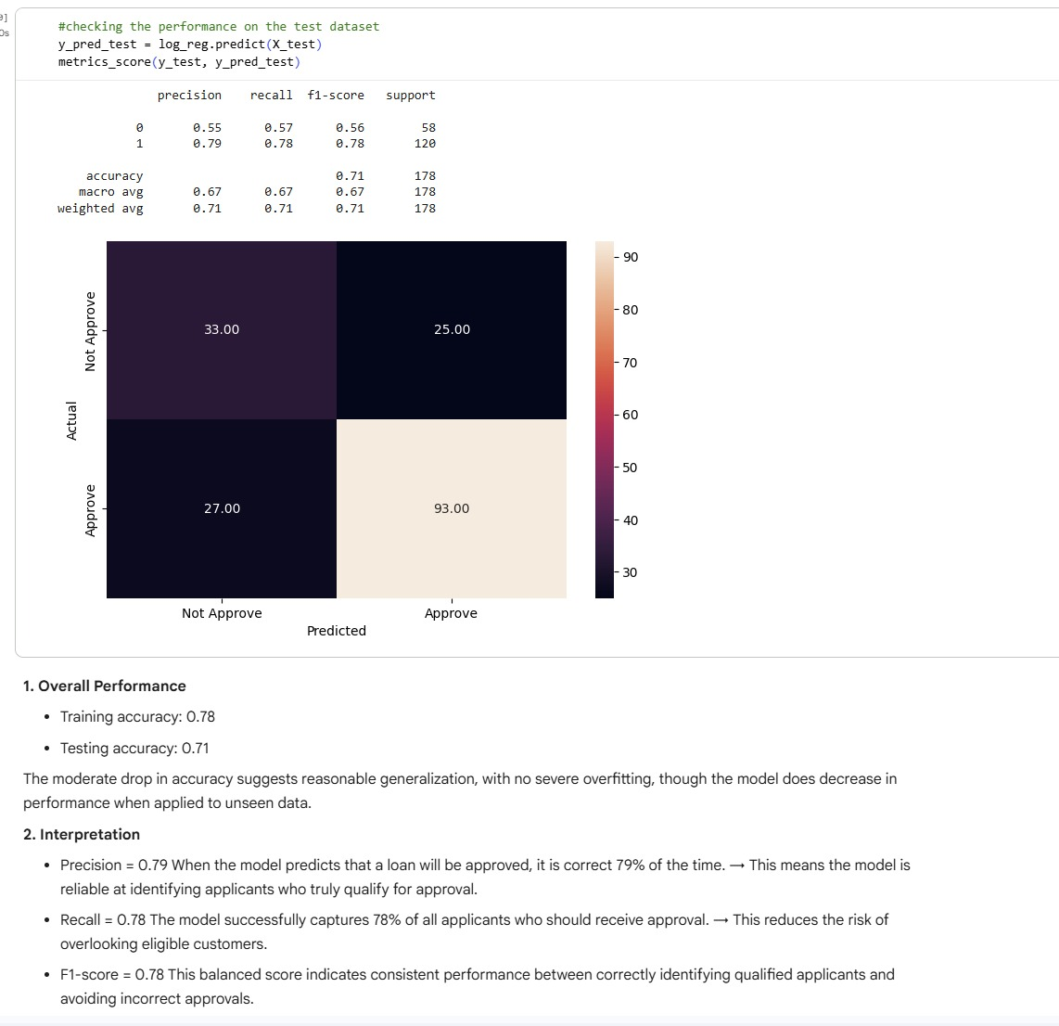
Model Performance
Precision = 0.79
When the model predicts that a loan will be approved, it is correct 79% of the time
Recall = 0.78
The model successfully captures 78% of all applicants who should receive approval
F1-score = 0.78
Consistent performance between identifying qualified applicants & avoiding incorrect approvals
78%
71%
Training Accuracy
Test Accuracy
The moderate drop in accuracy suggests reasonable generalization, with no severe overfitting, though the model does decrease in performance when applied to unseen data
Notes:
4

Slide 12
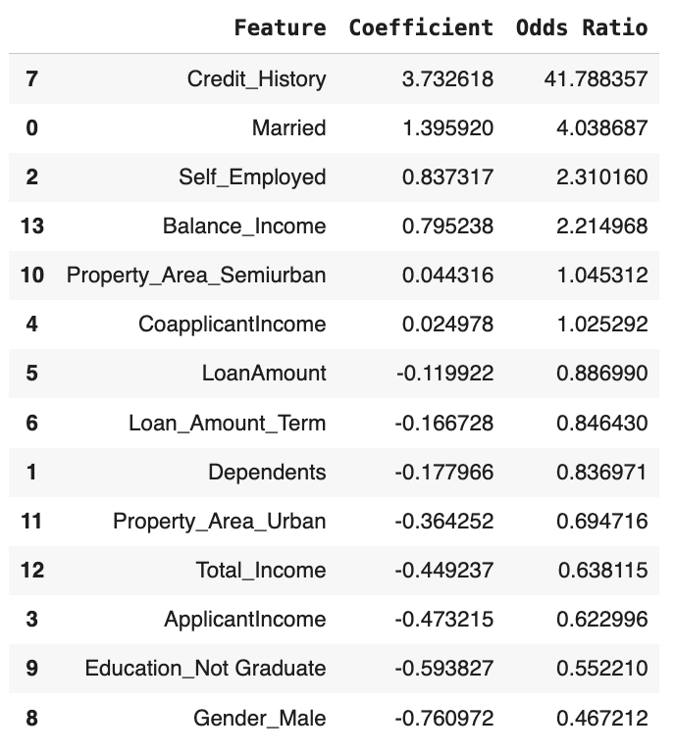




Key Drivers: Odds Ratios
Credit History (41.7x)
Applicants with a clean credit history are 41 times more likely to be approved than those with a poor credit history — by far the strongest predictor in the model.
Married (4.04x)
Married applicants are 4 times more likely to receive approval, holding other factors constant.
Self-Employed (2.31x)
Self-employed applicants have 2.3× higher odds of being approved than non–self-employed applicants.
Balance Income (2.21x)
Higher disposable income after EMI increases approval likelihood — each unit increase doubles the odds of approval.
Notes:
5

Slide 13

Model Comparison: Decision Tree
Notes:
1

Slide 14
Model Performance: Decision Tree
Captures Non-Linear Patterns
Accuracy
Effective in identifying complex interactions within data.
≈ 66%
Recall (Class 0)
Recall (Class 1)
≈ 0.62
≈ 0.68
Slightly lower accuracy than Logistic Regression
Notes:
2

Slide 15
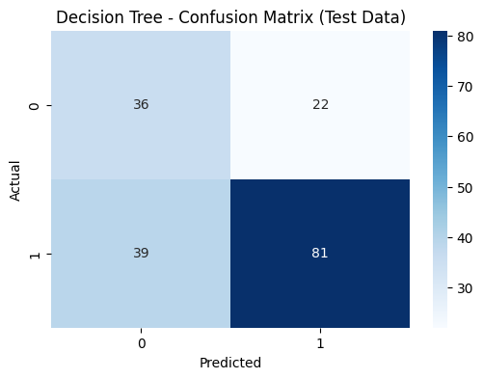
Key Insights
Good at identifying approved applicants (81 correctly predicted as approved).
Struggles with detecting risky applicants (39 risky cases incorrectly predicted as approved → high false negatives).
Also misclassifies some safe applicants (22 false positives), showing instability.
Indicates overfitting — the tree memorizes patterns but generalizes poorly.
Still useful for understanding key drivers such as Credit History, Income, and Loan Amount.
Notes:
2

Slide 16


Ensemble Model: Random Forest
Notes:
1

Slide 17



Model Performance: Random Forest
Ensemble of many tuned trees for robust prediction. Most robust and highest-performing model overall.
76%
0.53
0.88
Accuracy
Recall (Class 0)
Recall (Class 1)
Accuracy
The model predicts the loan approval outcome correctly for about 3 out of 4 applicants.
It shows strong overall predictive capability on unseen data.
It indicates the model has learned meaningful patterns from applicant features (credit history, income, loan amount, etc.).
Recall (Class 0)
The model correctly identifies 53% of high-risk applicants, providing moderate ability to catch potentially unsafe loans.
It detects about 1 out of 2 truly risky cases.
This indicates moderate sensitivity to the negative class.
Recall (Class 1)
The model correctly identifies 88% of safe applicants, showing a strong ability to approve the right customers.
It is very strong at catching applicants who are likely to repay.
This shows high sensitivity to the positive class.
Notes:
3

Slide 18
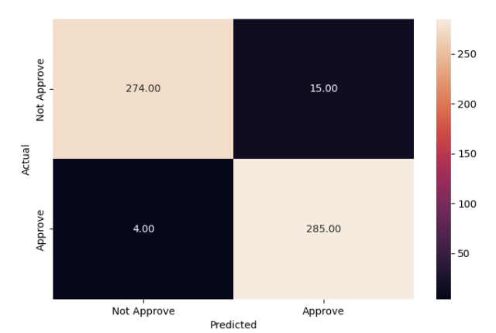
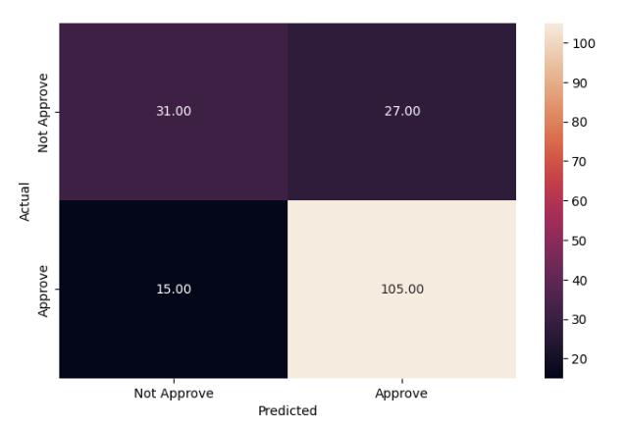
Confusion Matrix
Training Data:
“Almost perfect classification on training data — very low errors, suggesting strong learning but possible slight overfitting.”
Testing Data:
“Good performance on unseen data, strong at identifying approved applicants, with room to improve detection of risky cases.”

Slide 19
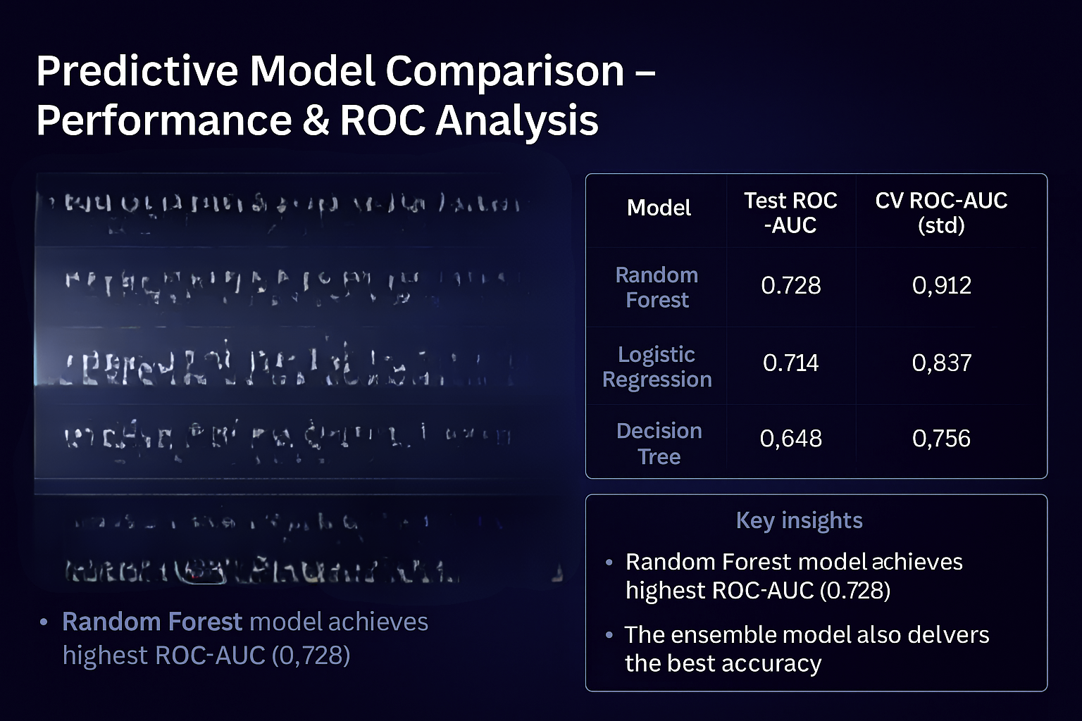
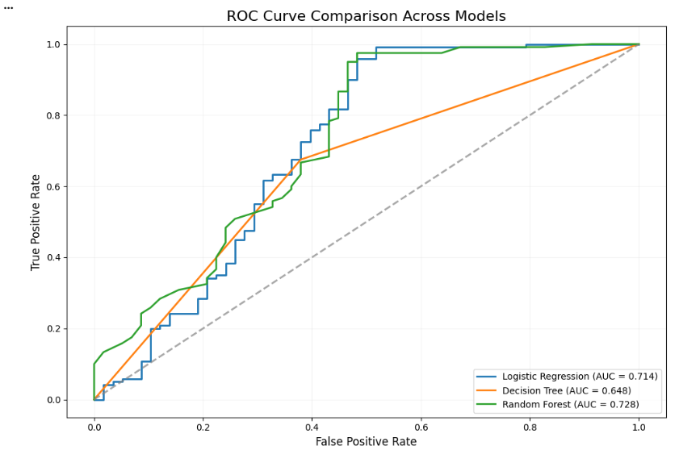

Slide 20


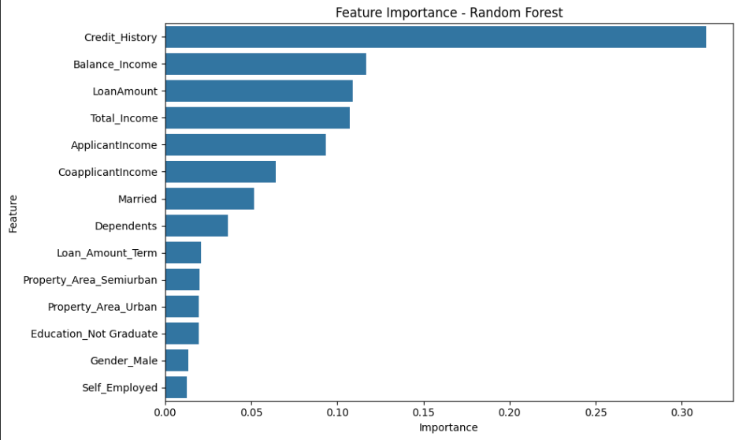


Key Drivers of Loan Approval
Credit_History
Strongest driver for approval likelihood.
Financial Health
LoanAmount, ApplicantIncome, Total_Income heavily influence approval.
Coapplicant Income
Contributes meaningfully to approval decisions.
Property Location
Semiurban > Urban > Rural in approval likelihood.
Notes:
4

Slide 21
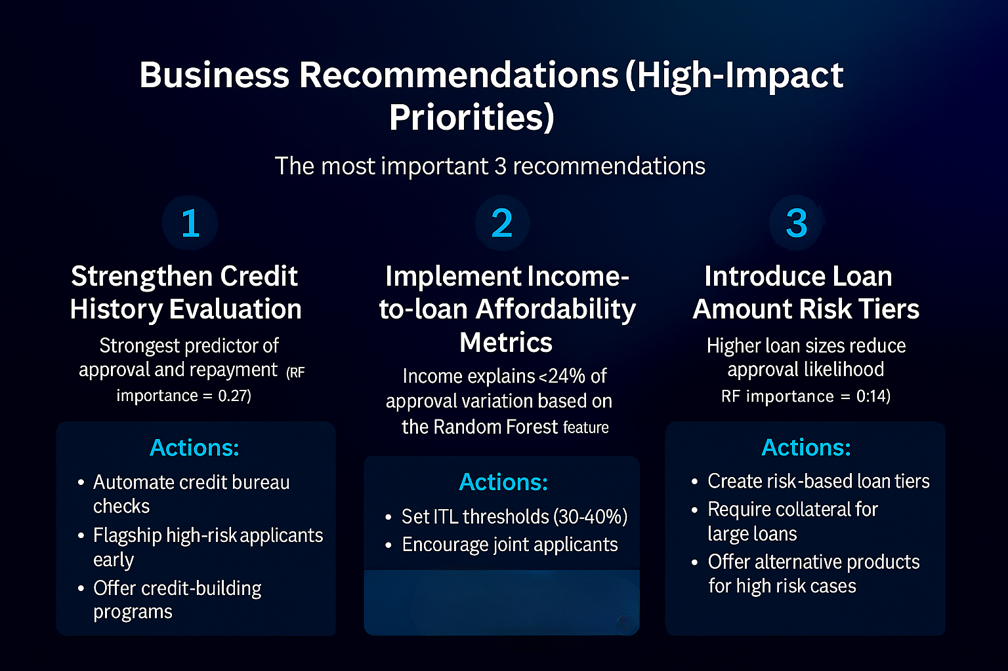
Strategic Business Recommendation
Business Recommendations(High Impact Priorties)
Higher repayment sucess
Reduced Delinquency

Slide 22
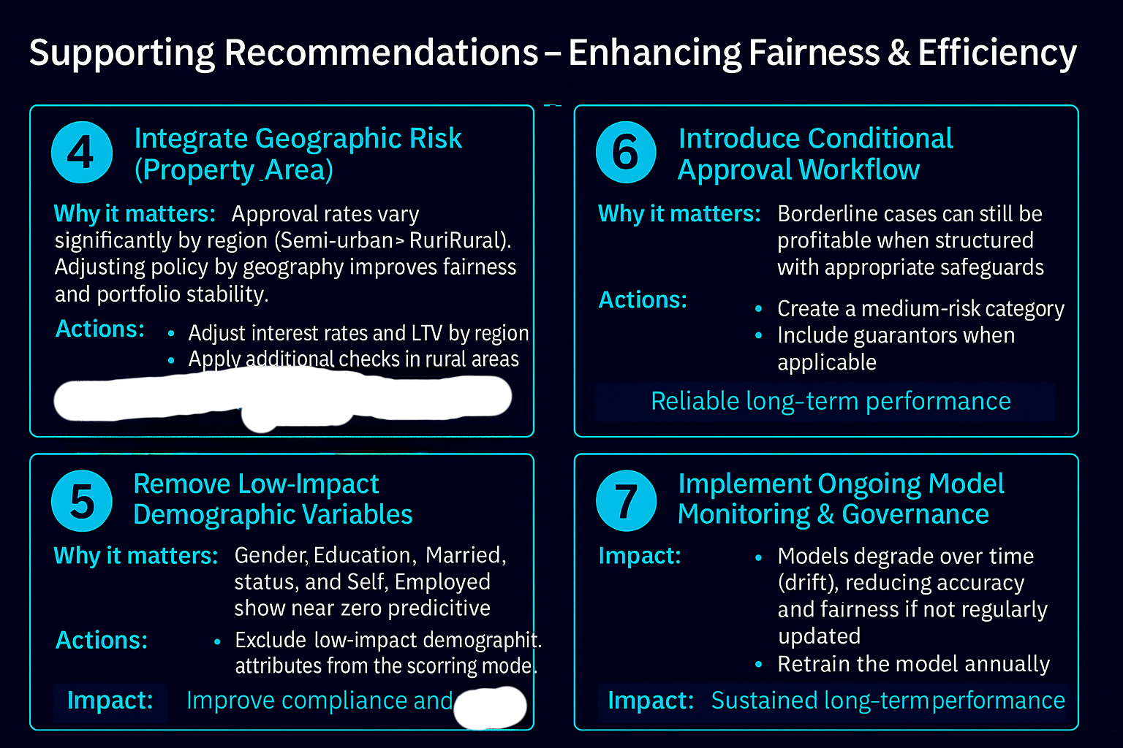
Improved segmentation & stability
fairness

Slide 23
Limitations and Future Enhancements
1
2
3
Small Dataset
Historical Bias
Missing Financial Depth
~600 rows limit generalizability of findings.
Past approvals may contain inherent biases.
Lack of data on debts, savings, employment length, collateral.
4
5
Future Model Upgrade
Dynamic Tuning
Explore XGBoost/GBM for improved performance.
Implement cutoff tuning and regular retraining.
Notes:
6

Slide 24
Thank You

